Slide 1
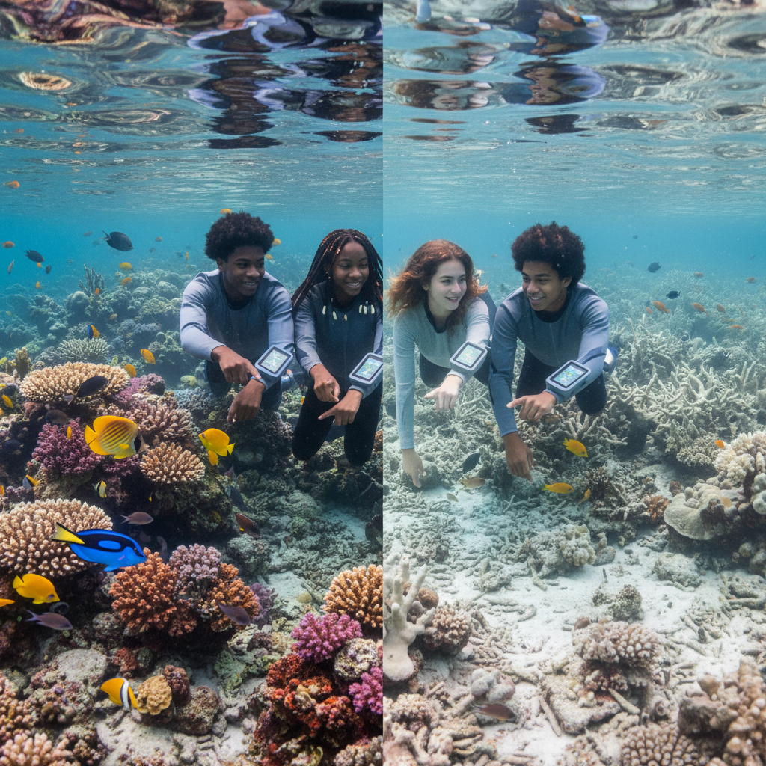
ModelIt!
Student Lesson
The Reef Is Bleaching
Why the World's Most Colorful Ecosystems Are Turning White
NGSS: MS-LS2-1, MS-LS2-4
8th Grade
1/9

Slide 2
What You Will Learn Today
Learning Goals
* Explain the symbiotic relationship between coral and zooxanthellae algae
* Model how rising ocean temperature disrupts the coral reef ecosystem
* Predict cascade effects when one component of an ecosystem is disrupted
* Evaluate human impacts on marine ecosystems using model evidence
Key Vocabulary
Coral Bleaching
When stressed coral expels its symbiotic algae, turning white and losing its energy source
Symbiosis
A close, long-term relationship between two different organisms that benefits at least one
Ecosystem Services
The benefits that healthy ecosystems provide to humans
Trophic Cascade
A chain of effects through a food web when one level is disrupted
2/9

Slide 3
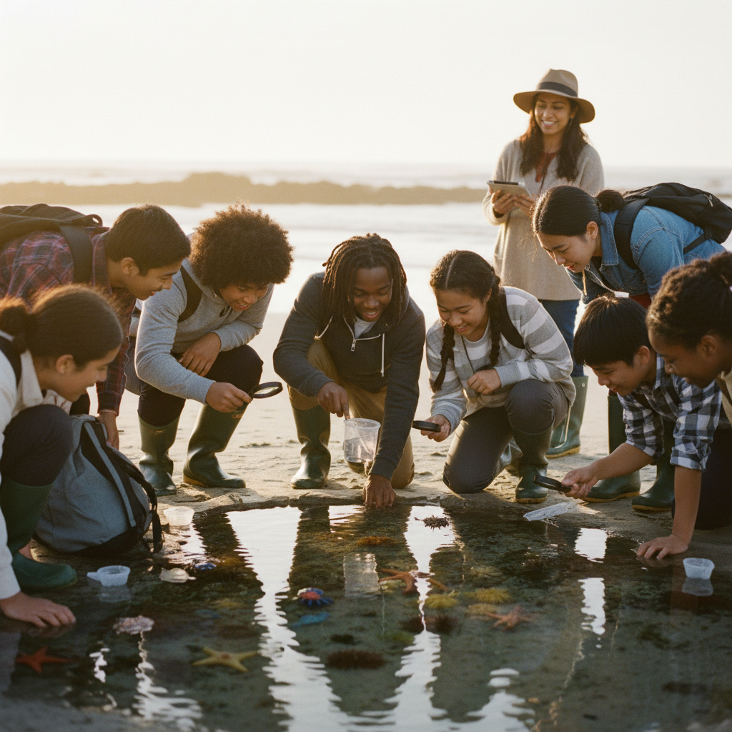
The Big Question
Why are coral reefs turning white and dying?
Why the World's Most Colorful Ecosystems Are Turning White. Today we'll build a MODEL to discover the answer!
3/9

Slide 4
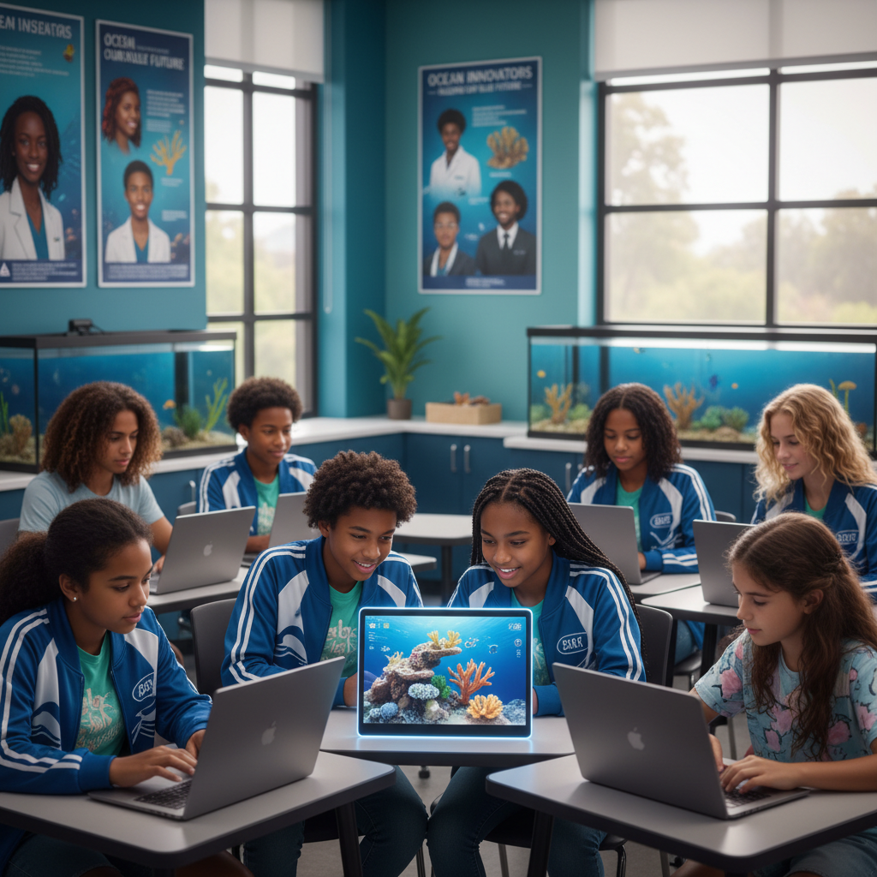
Today We Will Build a Model!
A model helps us understand complex systems!
1. LOCATE
Identify the COMPONENTS (parts) of the system
2. ESTABLISH
Connect them with RELATIONSHIPS (+ or -)
3. VISUALIZE
Build your model in ModelIt!
4. EVALUATE
Run SIMULATIONS to test scenarios
5. REVISE
Improve your model based on evidence
4/9

Slide 5
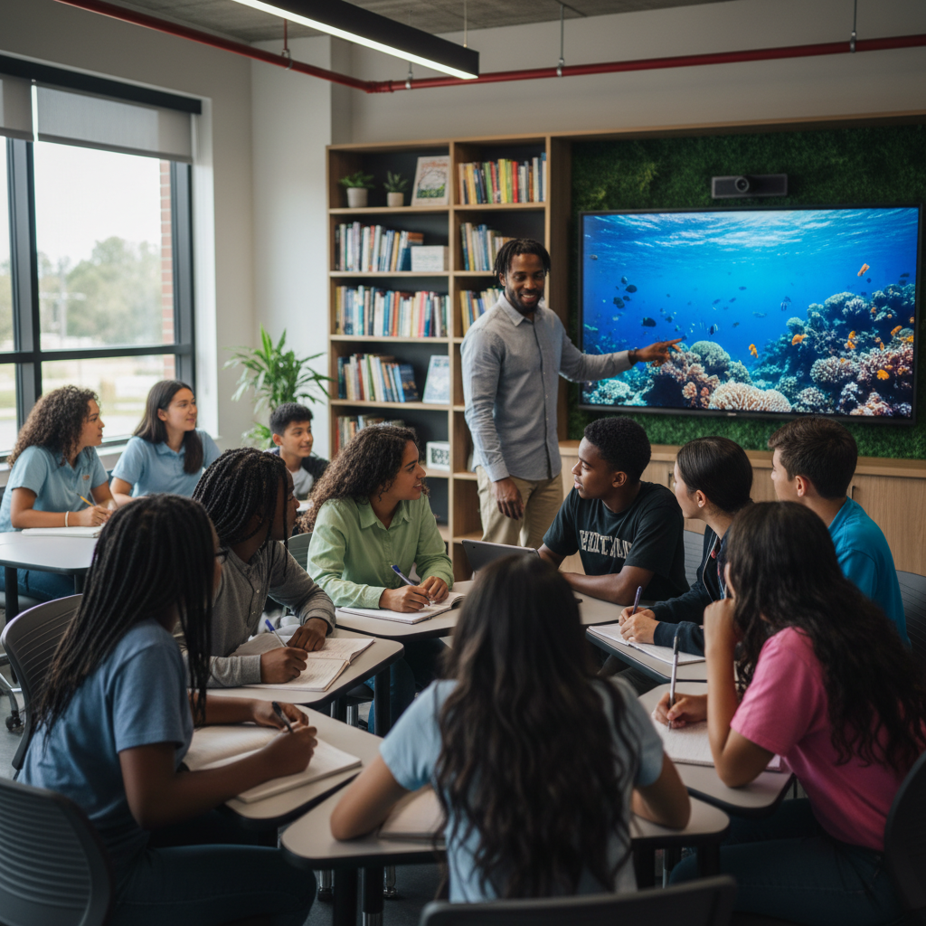
Activity 1: Sort the Components
Sort these components into EXTERNAL (inputs from outside) and INTERNAL (inside the system):
Your Components:
* Ocean Temperature
* Ocean Acidity (pH)
* Zooxanthellae Population
* Coral Health
Think: Which components can we control? Which happen on their own?
5/9

Slide 6
Activity 2: Connect with Arrows
Draw arrows to show HOW components affect each other:
(+) POSITIVE Relationship
When one goes UP, the other goes UP too
(-) NEGATIVE Relationship
When one goes UP, the other goes DOWN
Think About It:
When ocean temperature increases beyond normal levels, what do you think happens to the zooxanthellae living inside the coral?
6/9

Slide 7
Activity 3: Run the Simulation!
Test these scenarios in ModelIt!
Healthy Reef
Set Ocean Temperature and Acidity to normal levels
Marine Heat Wave
Lock Ocean Temperature to +3°C above normal and observe
Double Threat
Increase BOTH temperature and acidity simultaneously
Watch the activity graphs change!
[ModelIt Platform Screenshot - Simulation Results Graph]
7/9

Slide 8
What Did We Discover?
Our Model Showed Us:
* Coral depends on zooxanthellae algae for up to 90% of its energy
* When water gets too warm, coral expels its algae — that's bleaching
* Ocean acidification makes it harder for coral to build its skeleton
* The combination of heat AND acidity is far worse than either alone
Answer: Rising ocean temperatures cause coral to expel the symbiotic algae they depend on for food, turning white (bleaching) and eventually starving to death!
8/9

Slide 9
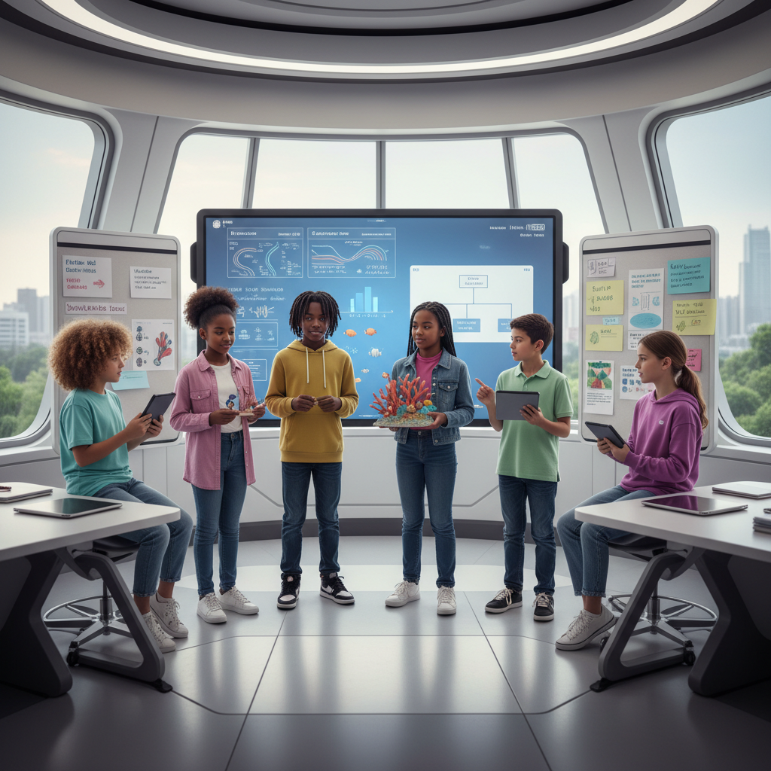
STEM Challenge: Design a Coral Reef Rescue Plan
YOUR ENGINEERING MISSION
Design a science-based plan to protect and restore a bleaching coral reef using evidence from your model.
The Challenge:
The Great Barrier Reef has experienced its worst bleaching event ever. Your marine science team has been hired to propose a rescue and prevention plan.
Think Like an Engineer:
* Which factors in your model can humans actually control?
* What temperature threshold triggers bleaching?
* How can we reduce ocean acidification locally?
REAL CAREER CONNECTION: Marine Biologists and Coral Restoration Scientists work to understand and protect ocean ecosystems. They earn $60,000-$100,000/year and work in some of the world's most beautiful locations. The skills you're using TODAY are the same ones they use on the job!
9/9

